Slide 1
CHAPTER 12 (Part 4)
Abstract Data Type
Consolidation

Slide 2
Using Multiple ADTs Together
To solve complex problems
We often need to combine multiple ADTs
Procedure
Produce output using an operation on one ADT
The output becomes the input for another ADT
This process can continue with multiple ADTs to eventually produce a result

Slide 3
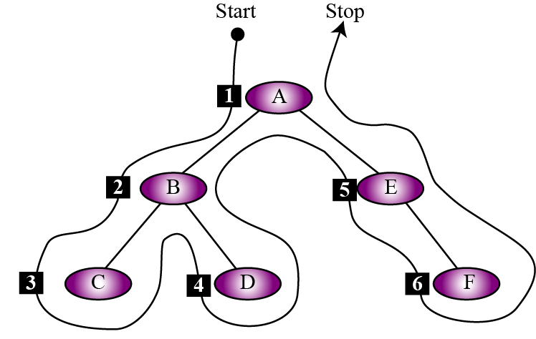
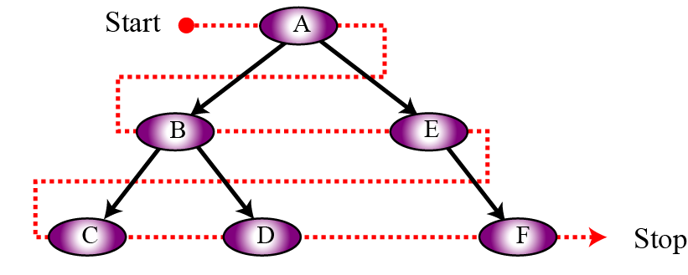
A Breadth-First Traversal
Let’s consider an example
We’ll assume a binary search tree
We want to perform a breadth-first traversal
This is not recursive like a depth-first traversal
We are processing level by level, not down subtrees

Slide 4
A Breadth-First Traversal
How can we print out the node keys in the right order?
We need a way to store the nodes to be printed
In the diagram below
First print A
Then A’s left child (B) and right child (E)
Then B’s left child (C) and right child (D)
The E’s right child (F)

Slide 5
A Breadth-First Traversal
In other words
Assume we are processing a node called n
We must delay the processing of n’s children
Until all the nodes on n’s level have been processed
In this example
We need to delay processing C and D
Until we’ve processed both B and E

Slide 6
A Breadth-First Traversal
So how can we do this?
Recall that a queue
Processes data in a FIFO order
It takes in data and releases it in the same order
So we can use a queue
To hold data that still needs to be processed
This is exactly what we need to do for a breadth-first traversal!

Slide 7
A Breadth-First Traversal
Create a queue, Q, and enqueue the root node
Now we need to process a node
Dequeue the node, n, at the front of Q
Process node n (print the key of n)
Enqueue n’s left child, then n’s right child
Stores children in the right order for processing
Start again at step 1
Prints n’s left child and enqueues its children, then prints n’s right child and enqueues its children

Slide 8
A Breadth-First Traversal
How do we know when to stop?
When the queue is empty
This means there are no more nodes to process

Slide 9
A Breadth-First Traversal
Algorithm: BreadthFirst(root)
Purpose: Performs a breadth-first traversal
Pre: Given: A pointer to the root node of a binary tree
Post: Prints the node keys in correct breadth-first order
Return: None
{
queue (Q)
enqueue (Q, root)
while (not empty (Q))
{
dequeue (Q, n)
print (n)
if (n.left is not null) enqueue (Q, n.left)
if (n.right is not null) enqueue (Q, n.right)
}
return
}

Slide 10
A Breadth-First Traversal
{
queue (Q)
enqueue (Q, root)
while (not empty (Q))
{
dequeue (Q, n)
print (n)
if (n.left is not null) enqueue (Q, n.left)
if (n.right is not null) enqueue (Q, n.right)
}
return
}
Q: |
Printed:

Slide 11
A Breadth-First Traversal
{
queue (Q)
enqueue (Q, root)
while (not empty (Q))
{
dequeue (Q, n)
print (n)
if (n.left is not null) enqueue (Q, n.left)
if (n.right is not null) enqueue (Q, n.right)
}
return
}
Q: | A
Printed:

Slide 12
A Breadth-First Traversal
{
queue (Q)
enqueue (Q, root)
while (not empty (Q))
{
dequeue (Q, n)
print (n)
if (n.left is not null) enqueue (Q, n.left)
if (n.right is not null) enqueue (Q, n.right)
}
return
}
Q: |
Printed: A

Slide 13
A Breadth-First Traversal
{
queue (Q)
enqueue (Q, root)
while (not empty (Q))
{
dequeue (Q, n)
print (n)
if (n.left is not null) enqueue (Q, n.left)
if (n.right is not null) enqueue (Q, n.right)
}
return
}
Q: | B E
Printed: A

Slide 14
A Breadth-First Traversal
{
queue (Q)
enqueue (Q, root)
while (not empty (Q))
{
dequeue (Q, n)
print (n)
if (n.left is not null) enqueue (Q, n.left)
if (n.right is not null) enqueue (Q, n.right)
}
return
}
Q: | E
Printed: A B

Slide 15
A Breadth-First Traversal
{
queue (Q)
enqueue (Q, root)
while (not empty (Q))
{
dequeue (Q, n)
print (n)
if (n.left is not null) enqueue (Q, n.left)
if (n.right is not null) enqueue (Q, n.right)
}
return
}
Q: | E C D
Printed: A B

Slide 16
A Breadth-First Traversal
{
queue (Q)
enqueue (Q, root)
while (not empty (Q))
{
dequeue (Q, n)
print (n)
if (n.left is not null) enqueue (Q, n.left)
if (n.right is not null) enqueue (Q, n.right)
}
return
}
Q: | C D
Printed: A B E

Slide 17
A Breadth-First Traversal
{
queue (Q)
enqueue (Q, root)
while (not empty (Q))
{
dequeue (Q, n)
print (n)
if (n.left is not null) enqueue (Q, n.left)
if (n.right is not null) enqueue (Q, n.right)
}
return
}
Q: | C D F
Printed: A B E

Slide 18
A Breadth-First Traversal
{
queue (Q)
enqueue (Q, root)
while (not empty (Q))
{
dequeue (Q, n)
print (n)
if (n.left is not null) enqueue (Q, n.left)
if (n.right is not null) enqueue (Q, n.right)
}
return
}
Q: | D F
Printed: A B E C

Slide 19
A Breadth-First Traversal
{
queue (Q)
enqueue (Q, root)
while (not empty (Q))
{
dequeue (Q, n)
print (n)
if (n.left is not null) enqueue (Q, n.left)
if (n.right is not null) enqueue (Q, n.right)
}
return
}
Q: | F
Printed: A B E C D

Slide 20
A Breadth-First Traversal
{
queue (Q)
enqueue (Q, root)
while (not empty (Q))
{
dequeue (Q, n)
print (n)
if (n.left is not null) enqueue (Q, n.left)
if (n.right is not null) enqueue (Q, n.right)
}
return
}
Q: |
Printed: A B E C D F

Slide 21
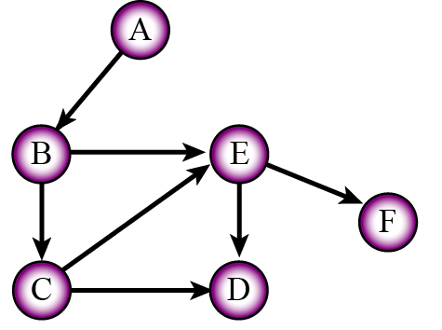
Complex ADTs
Sometimes we need more complex ADTs
We can store ADTs inside other ADTs
For example, consider a directed graph
We need nodes that store pointers to other nodes
Like a binary tree node
But we don’t know how many other nodes

Slide 22
Complex ADTs
How can we achieve this?
A linked list can contain any number of nodes
Instead of storing a left and right pointer
Store a linked list
Each linked list node stores a pointer to a node

